Slide 1
Awareness Campaign

Slide 2
What is TPOPP?
Transportable Physician Orders for Patient Preferences
Modeled on the Physician Orders for Life Sustaining Treatment (POLST) paradigm
One of the efforts underway nationally to address conversations about end of life care. POLST started in Oregon and Washington over 20 years ago.

Slide 3
Bringing TPOPP to
Kansas & Missouri

Slide 4
Notes:
TPOPP Wichita is in cooperation with the Center for Practical Bioethics in Kansas City, MO
We are working in cooperation with the program director, Sandy Silva, JD.
TPOPP is a bi-state initiative with Kansas and Missouri

Slide 5
Building the Bi-State Coalition
Started with KC Metro TPOPP Taskforce 2009
Small pilot Topeka 2010-2011
Provider interest across Kansas and Missouri
TPOPP Wichita Steering Committee began spring 2012
Bi-State Coalition Leadership
-- Concerted effort in past 12 months
-- Build the infrastructure and provide the tools
Standard of Care Implementation
Notes:
The aim was to improve end of life care in KS and Missouri.

Slide 6
What is ?
A community conversation initiative sponsored by TPOPP Partners: Via Christi Health, Wesley Medical Center and the Medical Society of Sedgwick County
Began in spring 2012 with health care leaders gathering to explore the TPOPP initiative. Aim was to improve end of life care.

Slide 7
Who Might Have a TPOPP Form?
Those who:
-- Live with advanced progressive chronic illness
-- May expect death to occur within the next year
-- Wish to further define their care wishes
TPOPP is NOT appropriate for:
-- A person with stable medical condition or disabling problem with years of life expectancy
-- Anyone who does not want it
TPOPP is a voluntary decision

Slide 8
Today’s Objectives
Explain illness trajectories that patients display prior to death.
Recognize TPOPP forms are for patients with chronic advanced illness or terminal illness.
Identify TPOPP as a physician order sheet for patient preferences that is coming in the next year. NOT YET available in the local hospitals or nursing homes.
Incorporate TPOPP into discussion of patient’s plan of care
Give overview of steps to join TPOPP initiative

Slide 9
What do people want/not want at end of life?

Slide 10
What do people want/not want at end of life?
Control at their end of life
Free of pain/other
physical suffering
Do not want death
prolonged
Do not want to die on
machines
Do not want to be a
burden on their family

Slide 11
Patients experience different types of Illness trajectories

Slide 12
Expected health trajectories may help to promote end of life decision making...
and provide a framework in which to integrate advance care planning (ACP) and TPOPP discussions

Slide 13
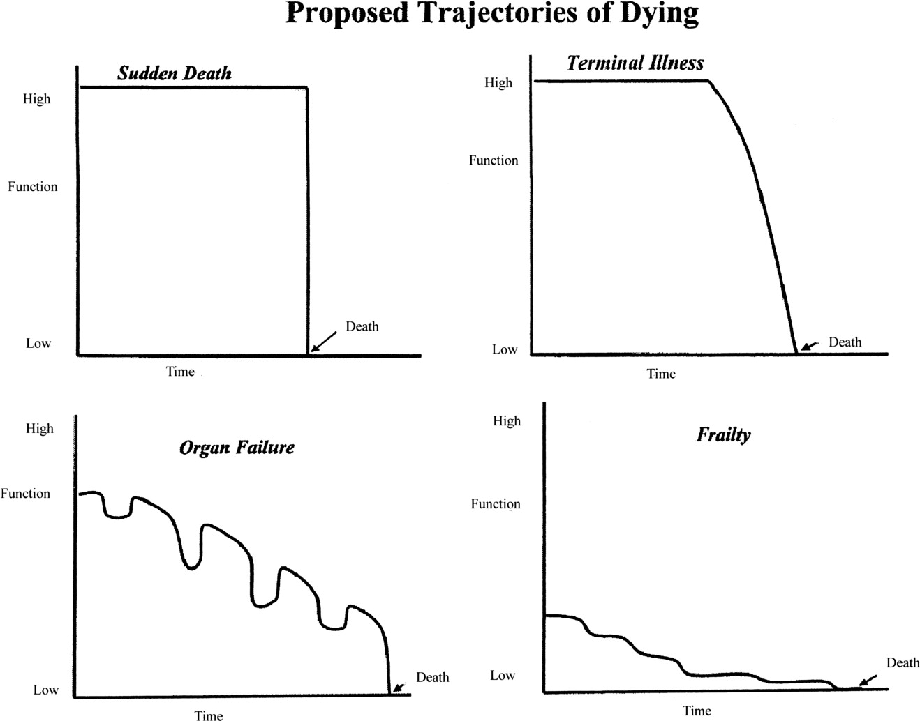
Figure 1. Trajectories of dying. Reproduced with permission of Blackwell Publishing (Lunney JR, Lynne J, Hogan C. Profiles of older Medicare decendents. JAGS. 2002;50:1108-1112). as cited in ScienceDirect.com

Slide 14
Illness Trajectories - #1
Sudden death – unexpected cause
< 10% (MI, accident, etc.)
Health Status
Death
Time
Field & Cassel, 1997
Notes:
Often older adults say they want to die in their sleep, a sudden death. But that is usually not what happens. The next few slides illustrate differences in the dying process (Field & Cassel, 1997).
We can also see when an advance care planning discussion might be planned in the illness trajectories.
A sudden death, unexpected cause might be related to an acute MI, t 86r or a motor vehicle accident.
In the hospital, home or nursing facility patients/residents do die suddenly and it may be an unexpected event, but often it relates to underlying conditions.
Field, M. J. & Cassel, C. K. (Ed.). (1997). Approaching death: Improving care at end of life. Division of Health Care Services. Institute of Medicine. Washington D.C.: National Academy Press.

Slide 15
Illness Trajectories - #2
Steady decline – short terminal phase
ACP and TPOPP
Health Status
Death
Time
Field & Cassel, 1997
Notes:
The yellow box above indicates Advance Care Planning and TPOPP discussion period.
A steady decline with a short terminal phase might occur in a patient with pancreatic cancer or a patient with a malignant brain tumor.
A sensitive conversation about preferences for EOL care may occur as part of discussions about hospitalization or consideration for hospice.

Slide 16
Illness Trajectories - #3
Slow decline – periodic crisis - death
ACP & TPOPP
Decline
Health Status
Crises
Death
Time
Field & Cassel, 1997
Notes:
Many older adults or residents in a nursing home will experience an illness trajectory of slow decline, periodic crises resulting in hospital admissions or interventions and finally death.
Persons with chronic, progressive conditions such as congestive heart failure (CHF), chronic obstructive pulmonary disease (COPD), and Parkinson’s disease often experience a slow decline with periodic crises and episodes of hospitalization, recovery and then worsening condition.
A good time to facilitate an advance care planning discussion or TPOPP talk is after an acute event. It offers a time to reflect on the recent acute experience and identify preferences for treatment in the future. In the hospital a good time for the discussion may be after the immediate crisis is over or when planning for discharge.

Slide 17
Chronic illness trajectory
Patients need to know the trajectory of their illness (what is ahead) and make a plan for the next “crisis” or anticipate what they want done at end of life.
-- Requires the system and the physician to recognize the illness trend and discuss with the patient goals of care
-- Requires planning from the hospital, the primary care physician, and the nursing home
-- Requires the coordinated effort of the support systems so the patient’s preferences are known across the continuum of care
Notes:
(You can omit this as a ‘slide’ and use it as your “notes” to discuss chronic illness…and eliminate from the slide show if desired.)ch

Slide 18
Lingering, Expected Death
Illness Trajectories - #4
Health Status
ACP & TPOPP
Frailty
Death
Time
Lunney et al., 2003
Notes:
Many of our frail patients slowly decline to death. The person with Alzheimer’s dementia or Parkinson’s disease will follow a pattern of slow, progressive and expected decline to death.

Slide 19
Where does death occur?
2.45 million deaths in 2011 in the U.S.
25% at home, 25% in long term care
50% of those happen in the hospital
75-90% of hospital deaths happen after a decision to remove or not start some form of artificial life support
Short hospice length of stay
35% of people are on hospice < 7 days
Median length of stay in hospice: 19 days
NHPCO Facts and Figures 2011

Slide 20
Why use TPOPP?
It is a Physician Order sheet
Form travels to all points of care
Minimizes confusion regarding a person’s treatment preferences at end of life

Slide 21
Why use TPOPP?
Clarifies treatment intentions and can be updated
It is about the patient’s wishes communicated with the physician

Slide 22
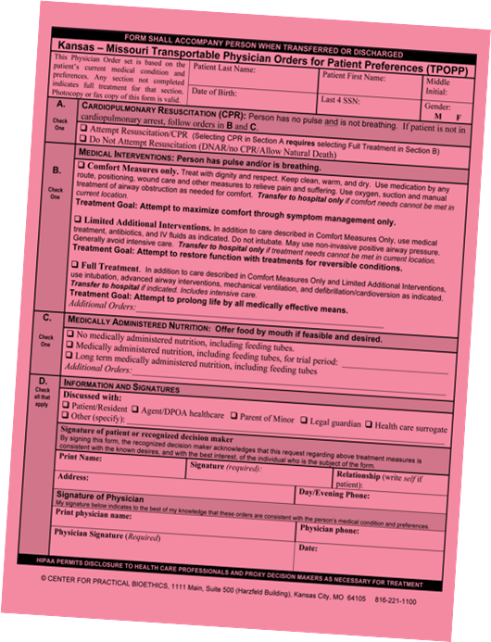
TPOPP Form

Slide 23
Form travels with person between health care settings
Form can be copied and original sent with patient when transferred to other facilities or to medical appointments
Notes:
How do you see this working in your facility?

Slide 24
A. Resuscitation Status
Section A: Resuscitation Status
FOR FULL BLOWN CARDIAC ARREST
Attempt Resuscitation (CPR)
Do Not Attempt Resuscitation *(DNR)
* If the Do Not Resuscitate box is checked– the TPOPP form stands as a DNR
order. No other DNR form is needed.
Notes:
TPOPP is NOT appropriate for a person with a stable medical condition or disabling problem with years of life expectancy
Less than 10% of death occur “suddenly with unexpected cause.” The rest relate to underlying conditions with predictable illness trajectories. (Field & Cassel, 1997)
99% of illness trajectories are categorized as “Steady decline, short terminal phase”, “Slow decline with periodic crisis” and “Lingering, expected death.”
AHA recommends the use of “out-of-hospital physician orders for patients who are chronically ill or have a terminal illness.” (American Heart Association Guidelines for Cardiopulmonary Resuscitation and Emergency Cardiovascular Care Science (2005). Part 8: Interdisciplinary Topics. Circulation. 112 (Suppl I), III-100 – III-108.)

Slide 25
TPOPP Form Treatment Goal Statements
Treatment Goals, located in Section B.
were created
To help patient and provider communicate the desired focus of intervention

Slide 26
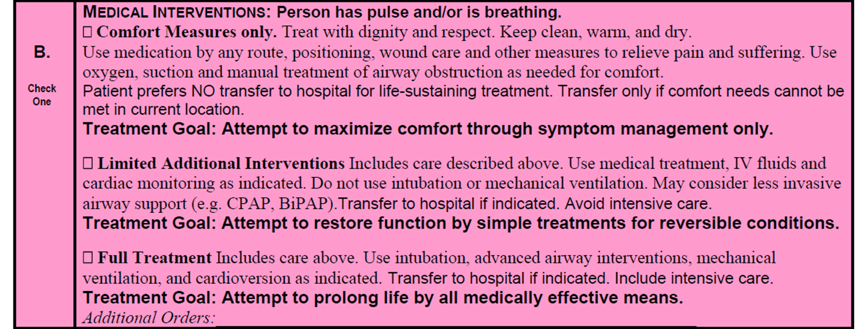
B. Medical Interventions
Notes:
Section B orders apply to emergency medical circumstances for a person who has a pulse and / or is breathing. The treatment orders range from full treatment to comfort measures only.
Comfort measures are always provided regardless of the indicated level of treatment. Section B: Medical Intervention
-- Still with pulse and breathing but
with rapid health deterioration
* Comfort Measures Only
* Limited Additional Interventions
* Full Treatment

Slide 27
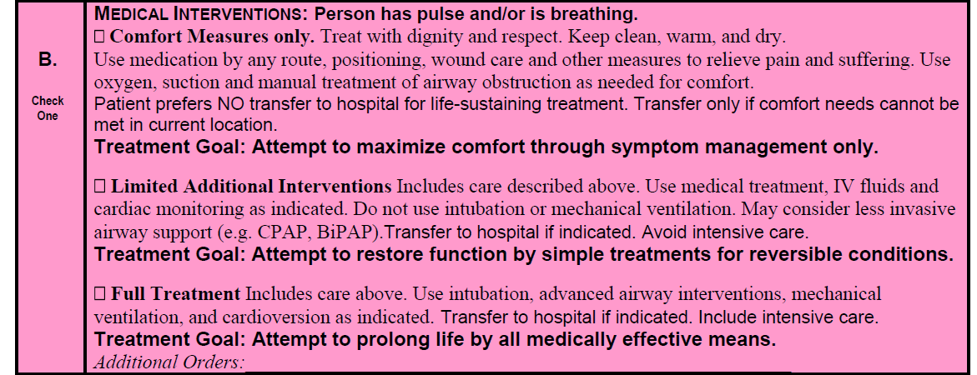
B. “Comfort Measures only” subsection
Notes:
Mary is receiving hospice care for metastatic breast cancer. She desires comfort care with all medical treatments to be focused on symptom management to maximize comfort.
Mrs. V’s son and DPOAHC would like to ensure that Mrs. V is not sent to the hospital again. Mrs. V has late stage Alzheimer’s dementia. Comfort care is consistent with Mrs. V’s health care directive and many statements she shared with her son about her wishes for the end of her life when she was able to communicate.

Slide 28
B. “Limited Additional Interventions” subsection
Notes:
Mr. Garcia’s Story: Mr. G has chronic bronchitis and COPD. He has had a least one bad episode of bronchitis leading to hospitalization in the past year. “ They put me on a breathing machine last time and I never want to do that again. I want the docs to give me medicine to help my breathing, but I don’t want to be on a ventilator. If I became that sick I want them to do what they can without the ventilator. If I can’t get better, I want them to make me comfortable.”
This option allows for less invasive airway support measures such as CPAP or BiPAP.
This option would focus on treating to restore function for reversible conditions.

Slide 29
B. “Full Treatment” subsection
Limited trial of ventilation. If no improvement in 2 week trial, patient requests removal.
Notes:
Based on Miss W’s preferences for treatment, medical interventions would be focused on the goal to attempt to prolong life by all medically effective means using full treatment measures.

Slide 30
Goal Statements
Goal statements provide more clarity for ultimate treatment aims for each level of medical interventions
Clarify goals with resident/surrogate to ensure consistency with resident’s preferences for end of life care
~ TPOPP Guidebook
Notes:
The goal statements appearing in bold text beneath each box in section B are designed to provide more clarity regarding the ultimate treatment aims of each category.
Refer to pages 13 and 14 in the TPOPP Guidebook to elicit goals and values.
Clarify the goal statements with the resident or resident’s surrogate decision maker to ensure that the goals are consistent with the person’s end of life preferences.
A story: Mrs. B tells you that she wants to be comfortable. It sounds like she expresses preference for comfort measures only. But as you share about the goals, Mrs. B’s answers do not seem congruent with the goal of symptom management to maximize comfort. She wants to go to the hospital for treatment, would want antibiotics and even ICU care if needed. Her preference for comfort should always be honored however her treatment goals would more closely reflect FULL TREATMENT.

Slide 31
C. Medically Administered Nutrition
Offer food by mouth if feasible and desired

Slide 32
D. Information and Signatures

Slide 33
When we are successful, what would it look like?
We will make a major improvement in matching the care we provide to the care our patients desire
We will impact how and where patients and their families experience end-of-life
We will improve the level of coordination across the care continuum for one of the most vulnerable populations while respecting their voice

Slide 34
So...Are You Ready to Join Us?
Readiness assessment (survey)
Local coalition formation with key stakeholders
-- Leadership
-- Passion, commitment
-- Outreach, education an performance improvement
-- Sustainability
Interdisciplinary Approach
-- Facilities: Hospitals, Independent Living Facilities, Assisted Living Facilities, Nursing Homes
-- Disciplines: MD, RN, SW, EMS, ATTY, Consumers

Slide 35
Steps to join TPOPP Wichita
Have ONE person complete survey for your facility/health care institution
Keep the original survey and mail a copy to:
TPOPP Wichita Chair TPOPP Development
Carolyn Harrison Sandy Silva
1125 N. Linden Cir Center for Practical Bioethics
Wichita, KS 67206 1111 Main St., Suite 500 Kansas City, MO 64105-2116
316-259-3810

Slide 36
Transportable Physician Orders for Patient Preferences
Wichita Area
Awareness Now
“Roll Out”
2014

Slide 37
“TAKE AWAY TODAY”
TPOPP is a physician order sheet
Designed for use in ALL health care settings and the community
JOINT effort of Via Christi Health, Wesley Medical Center, and the Medical Society of Sedgwick County

Slide 38
THANK YOU!

