Slide 1
HONORING WISHES FOR SERIOUS ILLNESS

Slide 2
TPOPP WICHITA Steering Committee
Carolyn Harrison, MN
Nurse Educator
Chair, TPOPP Wichita Steering Committee

Slide 3
CMS Quality Initiative Aims (2016)
Better Care: Improve the overall quality of care by making health care more person-centered, reliable, accessible and safe.
Smarter Spending: Reduce the cost of quality health care for individual’s families, employers, government, and communities.
Healthier People, Healthier Communities
Notes:
Important that we look at best practices. Center for Medicare and Medicaid wants hospitals to improve the care to make healthier patients, healthier communities, use their health care dollars more wisely.
Some of the goals of the CMS Quality Strategy:
Goal 2 Strengthen person and family engagement as partners in their care
Goal 3 Promote effective communication and coordination of care
Goal 4 Promote effective prevention and treatment of chronic disease
Goal 6 Make health care affordable

Slide 4
Serious Illness Conversation: Building the Case
Notes:
Dr. Atul Gawande utilizes this in the PBS Frontline, Being Mortal. Ariadne Labs created this conversation guide.

Slide 5
Person Centered Care
Drawing upon an individual’s needs, values and expectations to guide decision-making and caregiving is integral to long-term care.
Notes:
Two REASONS a constructed conversation can assist with care planning
The Serious Illness Conversation Guide shows best practices.
The Serious Illness guide leads us thru a systematic method of discussing the patients needs, values, expectations which help guide decision making and caregiving.
Discussing goals of care including the following
Sharing prognostic information
Eliciting decision-making preferences
Understanding fears and goals
Exploring views on trade-offs and impaired function
Wishes for family involvement

Slide 6
ROY’S STORY
IS THIS FAMILIAR?

Slide 7
Roy’s Story
71 years old with severe COPD and mild dementia.
In SNF after recent hospital stay for pneumonia.
Now having increased SOA & mental status changes.
EMS is called when resident “not responding” & RR 8/min O2 79%
Recent conversations with staff: “I don’t want to be kept alive by machines…. I want to die in peace.”
EMS applies oxygen and transports Roy to ER.
Notes:
Roy is 71 y.o. with severe COPD and mild dementia who moved to a SNF after recent hospital treatment for pneumonia.
Roy developed increasing shortness of breath and mental status change during the night.
The skilled care nursing staff called EMS when resident was not responding. (RR 8/min, O₂ saturation 79% on room air)
The resident recently discussed his wish to “not be kept alive by machines” and “to die in peace” with the nurse but this was not documented nor communicated to EMS.
Roy had appointed his out-of-state daughter as DPOAHC, but had no specific requests or wishes documented in the chart
Although a DNR was considered, the social worker was awaiting a conversation with Roy’s daughter. There were no treatment directions for respiratory failure. The EMS team inserted nasal pharyngeal airway, administered supplemental oxygen and transported resident to hospital.

Slide 8
In the Emergency Room
Patient unresponsive in ER
Hypoxic despite O₂
Chest X-ray: large lung volumes without consolidation.
Arterial blood gases: marked respiratory acidosis.
Intubated and transferred to ICU
Notes:
In the ER, Roy was unresponsive and hypoxic despite supplemental oxygen. His Chest X-ray showed large lung volumes without consolidation. Arterial blood gases showed marked respiratory acidosis. Roy was intubated and transferred to the ICU.

Slide 9
Family decisions
Roy’s daughter contacted. She made plans to come to hospital
Next few days, Roy becomes more responsive but still confused
Agitated and restless
Daughter distressed father’s wishes not followed.
Decision made to sign DNR order and to extubate
Notes:
Roy’s daughter was contacted and was making plans to come but she wouldn’t be able to arrive for another day.
She informed staff that Roy wouldn’t want life-support but she wanted to come to the hospital before making any further decisions.
Over next days, Roy became more responsive but remained confused.
With his daughter at the bedside, Roy became agitated and restless, pulling on ET tube. His daughter was distressed that her father’s wishes were not followed. Finally a decision was made to sign a DNR and extubate Roy.

Slide 10
Change in the focus of care
After ET tube removed, Roy calms.
Plans are made to transfer Roy back to the SNF.
After two days at the SNF, Roy dies.
Is this a familiar story?
Adapted form Lynn, J & Goldstein, N.E. (2003), Advance care planning for fatal chronic illness: Avoiding commonplace errors and unwarranted suffering. Annals of Internal Medicine, 138(10), 812-818.
Notes:
After the ET tube was removed, Roy calmed. Plans were made to transfer Roy back to the SNF. But after two days in the SNF, Roy died.
WHAT HAPPENED HERE? WHAT DID ROY WANT?
ELDERS “FOUND DOWN” ARE TREATED WHEN WE DON’T KNOW WHAT THEY WANTED.
Adapted from Lynn, J & Goldstein, N.E. (2003),
Advance care planning for fatal chronic illness: avoiding commonplace errors and unwarranted suffering Annals of Internal Medicine 138 (10), 812-818

Slide 11
Gap between what patients want and what they get:
Patients with serious illness have priorities besides living longer.
Symptom management and quality of life
Sense of control and completion
Strengthening relationships
Singer JAMA 1999; Steinhauser JAMA 2000; Heyland Palliative Medicine 2015

Slide 12
Gap between what patients want and what they get:
86% Medicare beneficiaries want to spend final days at home Barnato 2007
25-39% die in an acute care hospital Teno JAMA 2013; Silveira NEJM 2010
70% are hospitalized in the last 90 days Teno JM JAMA 2013
29% receive intensive care in the last 30 days Teno JM JAMA 2013
Many experience care transitions and short hospice stays Teno JM JAMA 2013
Notes:
We have to change this scenario:
How could Roy’s treatment been better? NOT been admitted to hospital. NOT intubated. DNR in the Skilled Nursing Facility

Slide 13
What patients get could harm them and their family:
Aggressive care for patients with advanced illness is often harmful:
For patients:
Lower quality of life
Greater physical and psychological distress Wright, AA JAMA 2008; Mack JCO 2010
For caregivers:
More major depression
Lower satisfaction of the care rec’d by their loved one Wright, AA JAMA 2008; Teno JM JAMA 2004
Notes:
Ethical principals of “DO NO HARM” and BENEFICENCE – do what is a benefit to the patient.

Slide 14
Conversations are too little, too late and not great!
Multiple studies show patients with serious medical illnesses do not discuss EOL preferences, or first discuss them only in the last days to month of life.
Wright 2008, Dow 2010, Halpern 2011

Slide 15
Conversations are too little, too late and not great!
Among patients with advanced cancer:
First EOL discussion occurred median 33 days before death.
55% of initial EOL discussions occurred in the hospital
Only 25% of these discussions were conducted by the patient’s oncologist. Mack AIM 2012
Conversations fail to address key elements of quality discussion, especially prognosis.

Slide 16
It is time to rename and reframe!
Not about “End of Life” discussions
These conversations are about a person’s priorities for how they want to LIVE.
These conversations are intended to help someone prepare over a course of months, even a year or two.
This is not about people at the end of life (right now), it is about people living with serious illness.

Slide 17
When is time to start Serious Illness Care Planning?
Asking the “surprise question” can help
Would it surprise me if this person were to die in the next year? (answer of “no,” it means it’s time)
NOTE: NOT the same as saying someone has a prognosis of a year or less
NOTE: for cancer and renal patients, surprise question does a better job of predicting mortality than our current Medicare Hospice Certification criteria
Recognizing functional trajectories of illnesses can help

Slide 18
Planning on the trajectory: what people need to know
If a person wants to die at home, not on machines, they, or their loved ones, need to know their trajectory of illness and make a plan for the next “crash”
Requires the system and the provider to recognize the trend and discuss it.
Requires planning from the hospital, the provider’s office, the nursing home.
Requires the support of community systems in a coordinated effort for preferences to be known across the continuum of care.

Slide 19
Non Cancer Illness Trajectory
Notes:
The most common clnical conditions relevant to this discussion include cancer, CHF, COPD, Chronic kidney disease or ESRD (end stage renal disease).

Slide 20
Frailty/Dementia Trajectory
Notes:
Elderly, frail individuals

Slide 21
How to bridge the gap between what patients want and what they get

Slide 22
Conversations are Key
Earlier conversations about patient goals and priorities for living with serious illness are associated with:
Enhanced goals of care Mack JCO 2010
Improved quality of life
Reduced suffering
Better patient and family coping
Higher patient satisfaction Detering BMJ 2010
Less non-beneficial care and costs Wright 2008, Zhang 2009

Slide 23
How do we do this serious illness conversation?

Slide 24
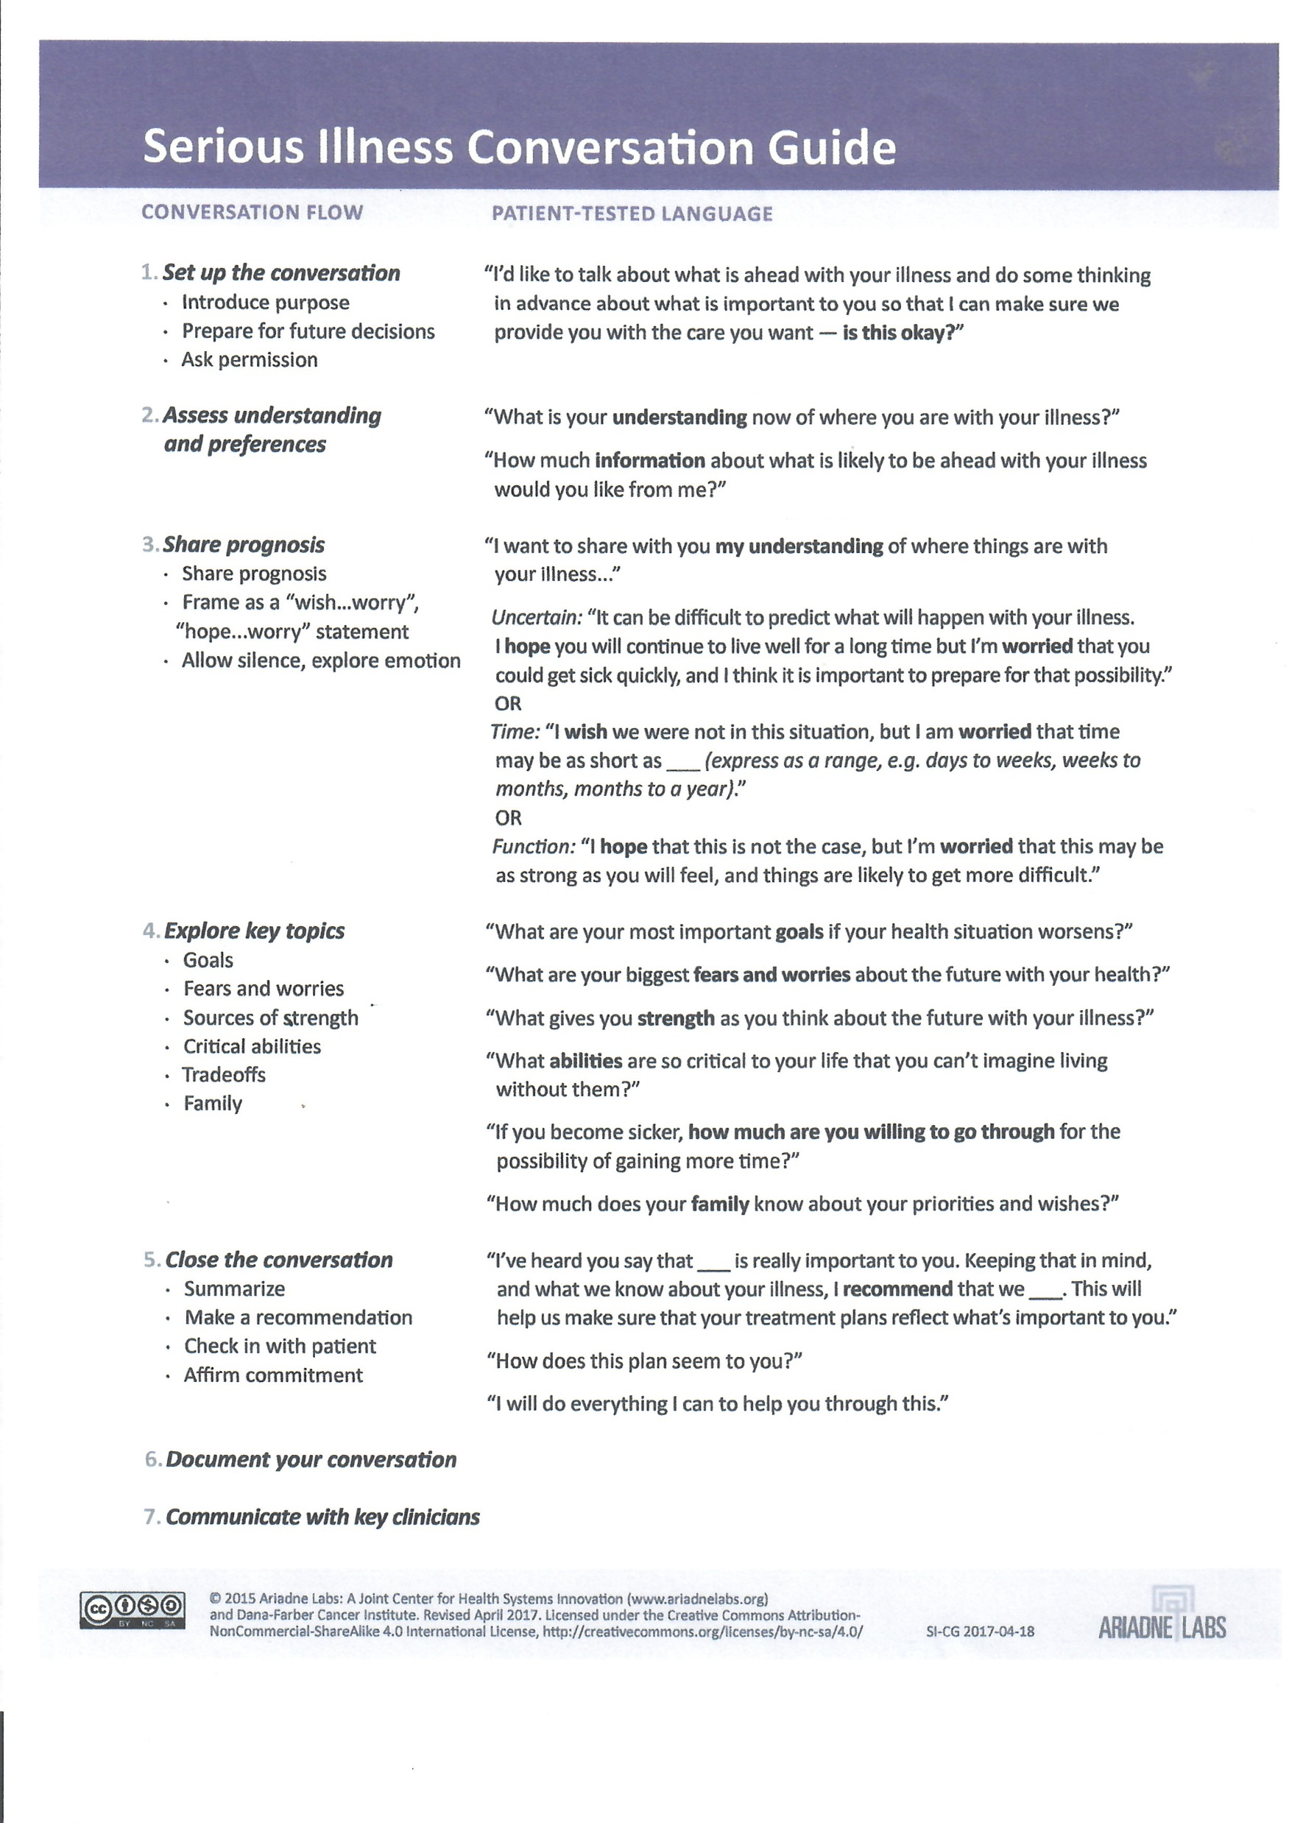
(see handout provided)
Or go to: www.talkaboutwhatmatters.org
Serious Illness Conversation Guide
revised April 2017 version

Slide 25
Using the serious illness care planning guide
Go to: www.ariadnelabs
Click on “FULL PLAYLIST” Choose video: Ariadne End-of-Life Conversation and Commentary Time: 34:03
Click on SERIOUS ILLNESS CARE box. More articles, sometimes videos.

Slide 26
Practice!!

Slide 27
THELMA
Thelma is a 74 y.o. female patient with 30 year history of diabetes, and bilateral AK amputee of lower extremities. She lives alone but has family support nearby. She has a history of heart disease: Bypass surgery 10 years ago; aortic valve replacement, and has been diagnosed with congestive heart failure in the last 5 years.
She has been admitted 2X last year to the hospital. Today she is in the ER because she has had difficulty breathing and she “is not feeling well.”

Slide 28
Potential Outcomes of Serious Illness Conversations
Conversation documented in medical record
Needs to be in a place where it is EASILY accessed by other providers. TPOPP/POLST form can be used.
Person’s current goals and wishes are documented
Can be billed by provider for using ACP codes activated by CMS January 1, 2016
ALL levels of care get the communication about patient.
Creation of TPOPP document

Slide 29
Potential Outcomes of Serious Illness Conversations
What Difference does it really make to talk about dying earlier? WBUR Common Health Newsletter – a weekly digest for health medicine and science coverage.
Patients and families cut anxiety and depression (according to a 4 year study that followed 278 Dana-Farber Cancer Institute patients with advanced cancer
Moderate to severe anxiety was only half as common as among those in the conversation group and this improvement persisted for months.
Affect on medical treatment: NO significant effects on reducing unwanted or unhelpful measures. Sample size was small and # of deaths were small in groups.
It found no clear improvement on dying more peacefully or getting care tailored to personal goals and no change in survival time.The serious illness conversations happen a couple of months earlier, about 5 mos. Before the death.

Slide 30
What is TPOPP?
TRANSPORTABLE PHYSICIAN ORDERS FOR PATIENT PREFERENCES

Slide 31
What is POLST?
Physicians Orders for Life Sustaining Treatment (www.polst.org), started in Oregon in 1991
Converts patient preferences for treatment into:
Orders that move with the patient across the continuum
Reviewed and respected as appropriate by care providers all along that continuum
>40 states presently working on paradigm development
Different names in different places (MOLST, POST, TPOPP), all have the same POLST paradigm elements

Slide 32
POLST Paradigm
Term “POLST paradigm” used to describe programs with consistent components, but different names
MOLST – New York
MOST – North Carolina
POST – West Virginia
TPOPP – Kansas - Missouri
www.polst.org
Notes:
MOLST – Medical Orders for Life Sustaining Treatments
MOST – Medical Orders for Scope of Treatment
POST – Physician Orders for Scope of Treatment
TPOPP – focus on patient preferences

Slide 33
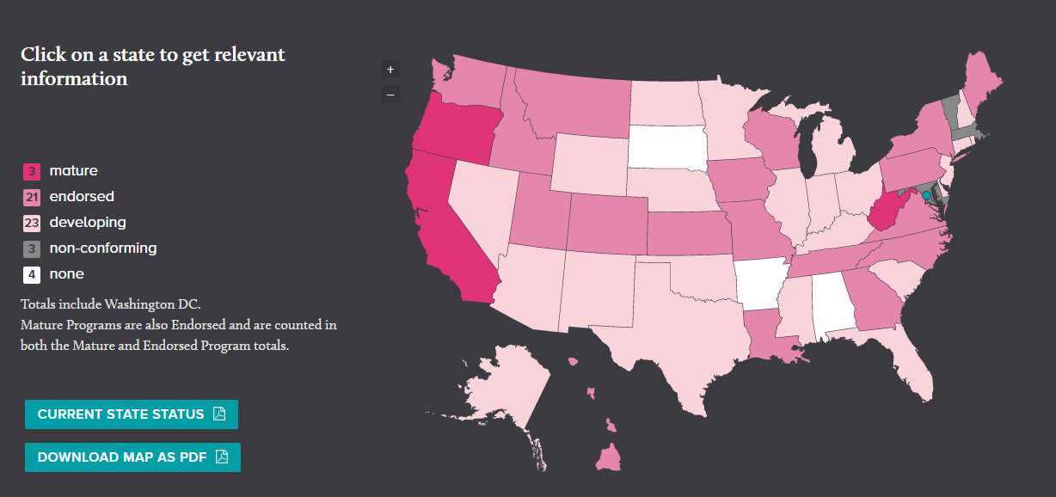
POLST programs nationwide
Notes:
As of August 2010 the are 9 endorsed POLST programs nationwide and 24 states have developing programs.

Slide 34
POLST as Preferred Practice
“Compared with other advance directive
programs, POLST more accurately conveys
end-of-life preferences and yields higher
adherence by medical professionals.”
National Quality Forum
A National Framework and Preferred Practices for Palliative and Hospice Care Quality:
A Consensus Report. Washington, D.C.(2006)

Slide 35
Bringing TPOPP to Kansas and Missouri
Transportable Physician Orders for Patient Preferences (TPOPP) (paradigm of POLST)
Started with KC Metro TPOPP taskforce 2009
Pilot Topeka 2010-2011, still on ground there today
Bi-State Coalition formed 2012
Started in Sedgwick County 2014
14 active local coalitions in KS and MO
12 additional interested communities

Slide 36
Community Coalition Approach
Clinical consensus regarding standard of care
Non-legislative route has greater flexibility
Can keep pace better with changes in health care practice
Will still need support from key regulatory entities and partners such as First Responders, Long Term Care, Hospices, Home Health, Transitional Care Clinics, etc
No Kansas statewide adoption at this time.

Slide 37
Advance Directive vs. TPOPP
Advance Directives | TPOPP
For all adults | For those with chronic progressive illness or may die within the year
Complete for the future | Applies to person’s current situation. Medical orders for now.
In effect when decision-making capacity is lost | Not conditional on decision- making capacity. Others can decide for patient who does not have capacity.
Contains no medical orders | Set of medical orders
May not be available in all settings | Accompanies patient across settings
Notes:
This slide outlines the differences between an advance directive and TPOPP. TPOPP is not an advance directive but a physician order set.

Slide 38
Advance Directives: Not Enough
Focus on potentially life-prolonging treatments in limited set of circumstances
Does not translate into medical orders for present circumstance
Completion rate low
Reliance on surrogate decision maker
Not available
Notes:
Studies show only 20-30 Americans have an advance directive.
Advance directives often have limited effects on treatment decisions at end-of-life.
There are many reasons why traditional advance directives are less successful than originally hoped:
Focus is on refusing unwanted medical treatments – persons may not receive assistance in understanding or discussing underlying goals and values.
Instructions given may be vague “If I am close to death” or too medically specific to be helpful “If I am in a persistent vegetative state.”
AD may not be updated. The only question a patient may hear is “do you have an advance directive?”
Surrogate decision makers may not know or understand a person’s preferences.
The advance directive may not be available in the setting to guide decisions.
Hickman, Hammes, Moss & Tolle (2005).

Slide 39
Elements of TPOPP Program
TPOPP FORM
a medical order
standardized – pink paper
for persons with advanced illness
transfers with patient/resident
directs resuscitation status
express limits or desire for treatment
includes other interventions
Notes:
POLST paradigm programs share similar elements.
There are three major elements of the TPOPP program: development of the form, training, and evaluation
1.TPOPP form
A set of medical orders
Standardized – bright pink.
Used for persons with advanced, progressive chronic illness.
Travels and transfers with the patient across all health care settings.
Provides clear direction about resuscitation status.
May be used to limit treatment or express desire for full treatment.
Includes clear directions about other interventions & life-sustaining treatments.
.

Slide 40
Target populations to use TPOPP
Those who:
Live with advanced progressive chronic illness.
Are terminally ill.
Might die within the next year.
Wish to further define their care wishes.
Notes:
TPOPP form allows an individual to communicate a wide of preferences.

Slide 41
But it’s not for everybody
TPOPP is not appropriate for person with stable medical condition or disabling problem with years of life expectancy.
TPOPP is a voluntary decision.

Slide 42
Advance Directives and Where Does TPOPP Fit?
DPOA-HC
Living Will
Do Not Resuscitate
TPOPP
Transportable Physician Orders for Patient Preferences

Slide 44
Put Serious Illness Care Planning into action
Develop institutional algorithms to identify seriously ill patients, where the surprise question, “Would you be surprised if this patient dies in the next year?” and if the answer is “no”.
Develop workflows and training for providers to have more, better, earlier serious illness care planning conversations, using the Serious Illness Conversation Guide.

Slide 45
Put Serious Illness Care Planning into Action
Develop EMR tools that make outcomes of serious illness conversations as obvious as the allergies.
For patients who wish their preferences for treatment to be translated into transportable physician/provider orders, build the tools and institutional/community infrastructure necessary to create and honor POLST paradigm documents (TPOPP).
Notes:
Challenges…building the team takes time. Maintaining the goals of the committee is hard. Need chapions at hospital settings, transitional clinics, those treat the patient population that need serious illness conversations.

Slide 46
Documenting the Conversation TPOPP FORM

Slide 47
QUESTIONS?

